Slide 1
MEDPAD
PIP104 University Project-II
Final Review
Batch Number: 205
Roll Number | Student Name
20211IST0023 | Hitesh D
20211IST0026 | Sushmitha V M
20211IST0020 | Shamitha R
Under the Supervision of,
Dr. Pallavi R
School of Computer Science & Engineering
Presidency University
Name of the Program Project Coordinator: Prof. Srinivas Mishra
School of Computer Science & Engineering
Presidency University

Slide 2
Problem Statement
Inefficient working done by Medical Representatives is one of main reasons for the poor sales figures of Pharmaceutical companies. Poor MRs in a company are like poor politicians, you need them also and can’t do much to improve their performance also. Medpad is a one stop solution consisting of all tools which can help a Medical Representative work with a lot more efficiency and yield better results.
Medpad is an application expected to be used by Medical Representatives to perform their daily word. Medpad is packed with a lot of unique features which will surely help attain the goal of 10x prescriptions.
Creating a web application for MRs to facilitate achievement of the goal of 10x prescription. The idea is expected to yield efficient sales figures from MRs as well as expedite the communication between doctors and Medical Representatives.

Slide 3
Features of Med Pad
Some of the striking features of the platform include -
1. A recommendation system for the MR which will recommend him as to where to reach out with his product. The machine will make this recommendation based on the previous sales figures by analysing them using machine learning algorithms.
2. The portal will act as a platform for storage for all the marketing material like brochures, flyers etc. which in current day scenario the MR roams around carrying in his bag.
3. The portal also houses a review system wherein the MR can take review for a medicine from a doctor and then a sentiment analysis can be performed on the review data collected.
4. Med Pad will also have a video conferencing feature with which the MR can video conference with a doctor located in some remote location, where reaching otherwise is not feasible. This is supposed to be the most striking feature of the platform since it has the potential of garnering prescriptions from locations where no other companies have reached and also people in that region are in a need of proper medication, but cannot attain the same due to the remoteness of the location

Slide 4
Objectives
MedPad is designed to address the inefficiencies in the daily operations of Medical Representatives (MRs) and enable them to reach their goal of 10x prescriptions. The objective of this project is to create an all-in-one, user-friendly mobile and web application that equips MRs with tools to enhance productivity, streamline doctor communication, and ultimately boost sales performance.
Here are the primary objectives of the MedPad project:
1. Enhance MR Efficiency through Data-Driven Insights
Objective: Provide MRs with real-time data analytics and AI-driven insights to make smart, data-backed decisions.
2. Streamline Doctor Communication and Engagement
Objective: Facilitate quick and efficient communication between MRs and doctors, improving relationship building and response times.

Slide 5
Objectives
3.Increase MR Motivation and Sales Performance
Objective: To boost MR motivation and overall sales performance where sales statistics .
4.Creating a Robust, User-Friendly Platform
Objective: Ensure that the platform is intuitive, easy to use, and minimizes the learning curve for MRs.
5.Product Recommendation System
Objective:significantly enhance the effectiveness of Medical Representatives (MRs) by providing data-driven suggestions on which pharmaceutical products to promote to specific doctors.

Slide 6
Methodology
1. Project Planning & Requirement Gathering
Objective: Define the scope of the project, gather detailed requirements, and set clear goals.
2. Design & Architecture
Objective: Design the system architecture and application workflow, ensuring the recommendation engine is scalable, responsive, and integrated seamlessly with the app.
System Architecture Design:
MERN Project
Frontend ( Web): HTML, CSS, JavaScript ,React.js
Backend: Implemented using Node.js.
ML Recommendation System: Sales statistics and Top-Selling Products Suggesting products, considering sales trends and doctor preferences.
API’s: Jitsi

Slide 7
Methodology
Database Design:
Mongo Db
Wireframes for Designing Frontend pages:
Design wireframes for MR dashboards, recommendation screens, etc.

Slide 8
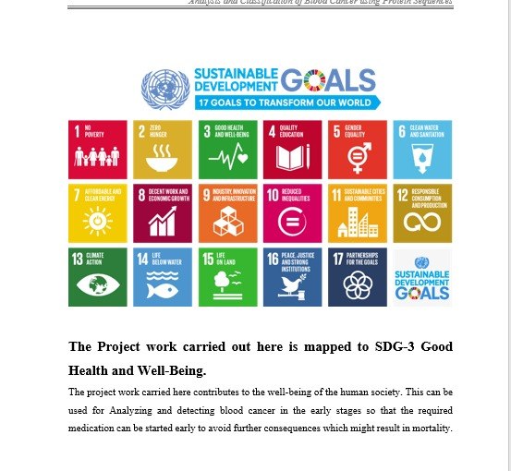
SDG Mapping

Slide 9
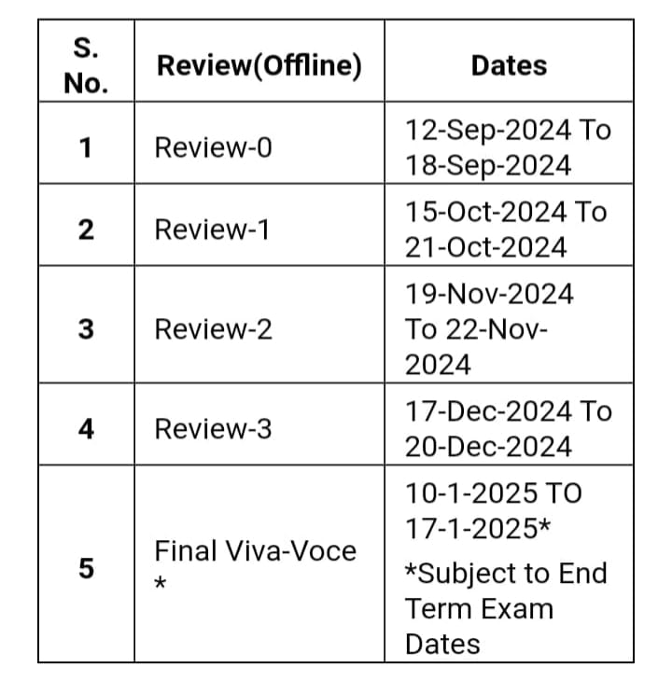
Timeline of Project

Slide 10
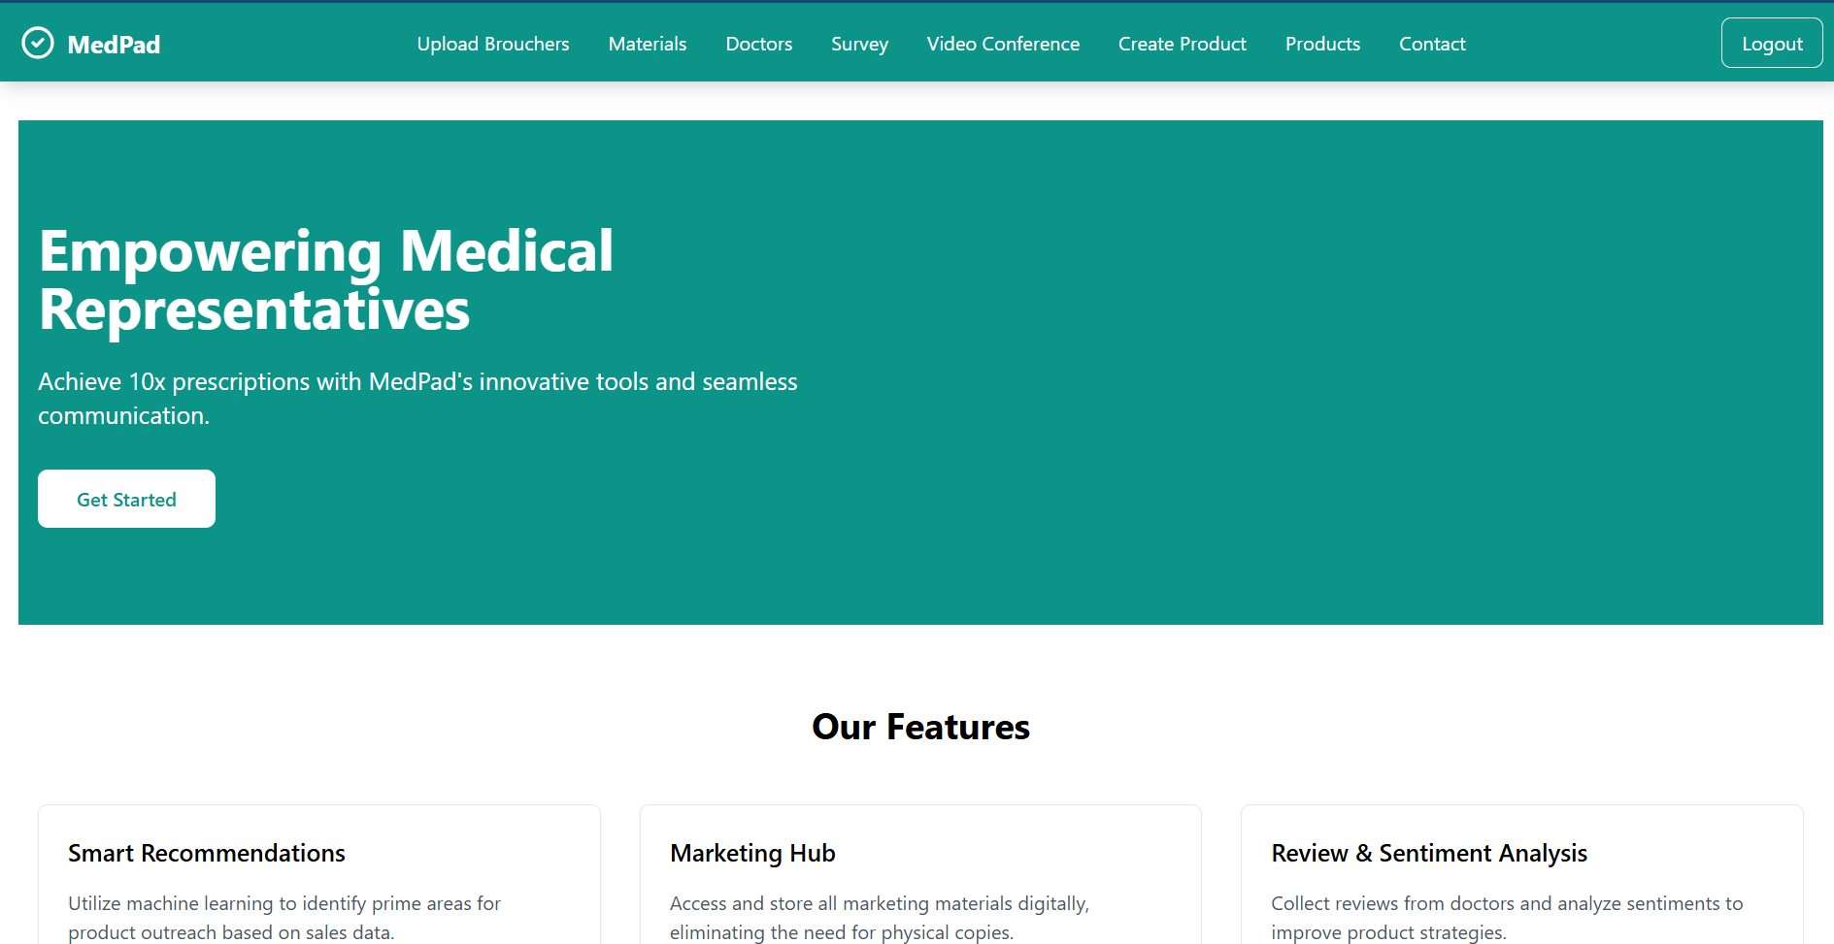
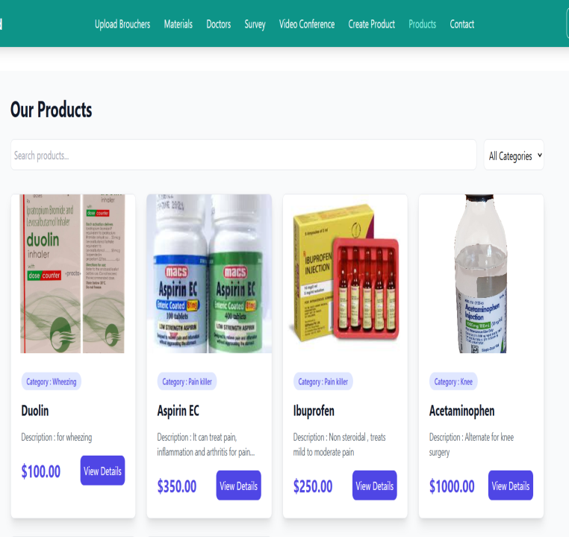
Outcomes

Slide 11
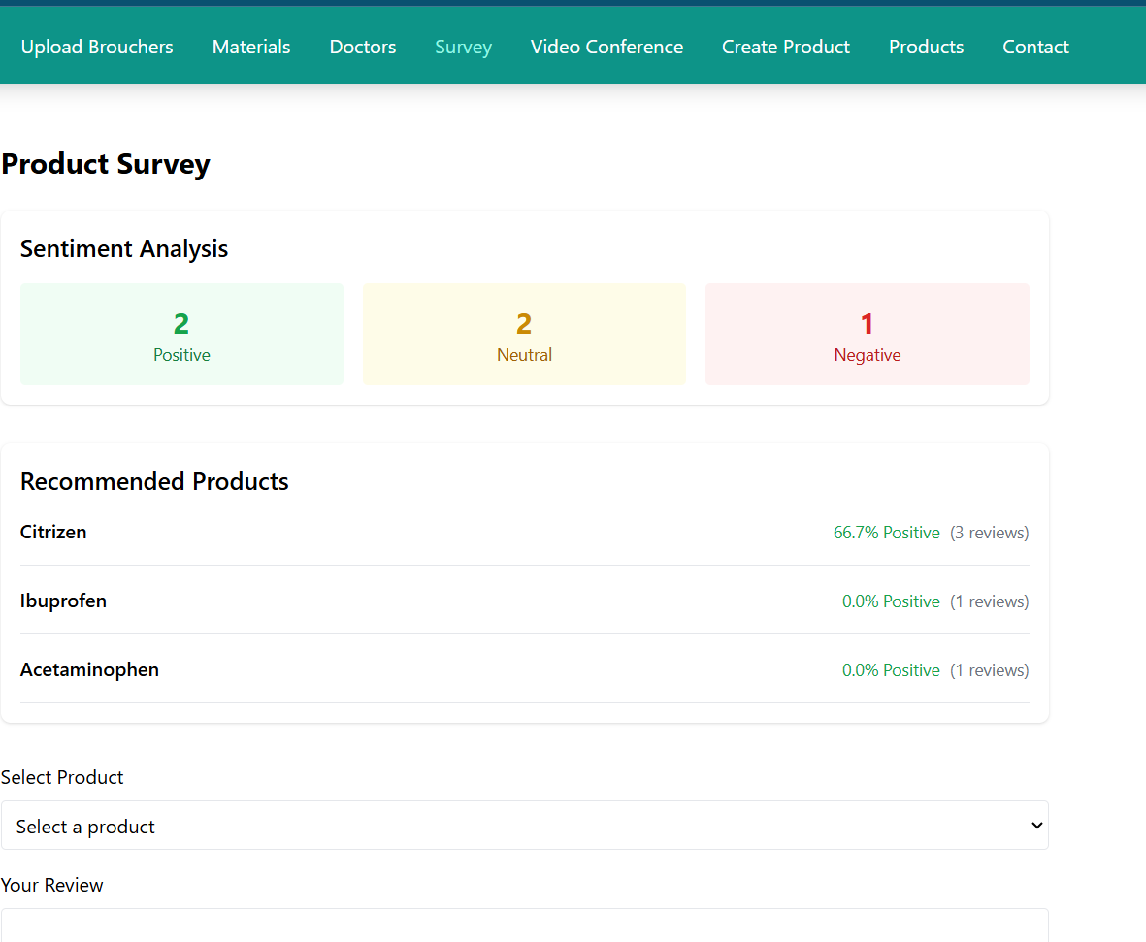
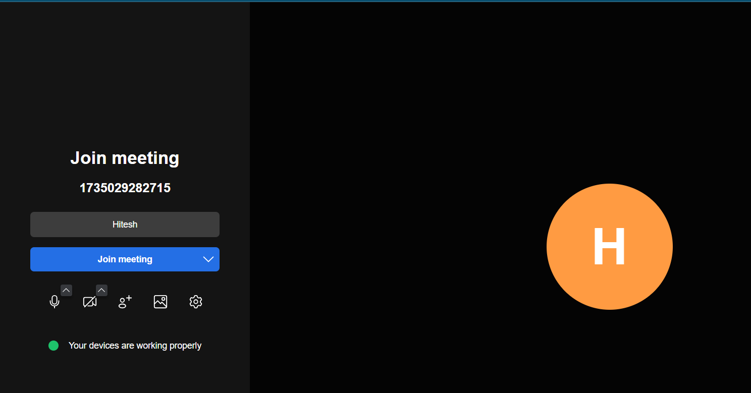
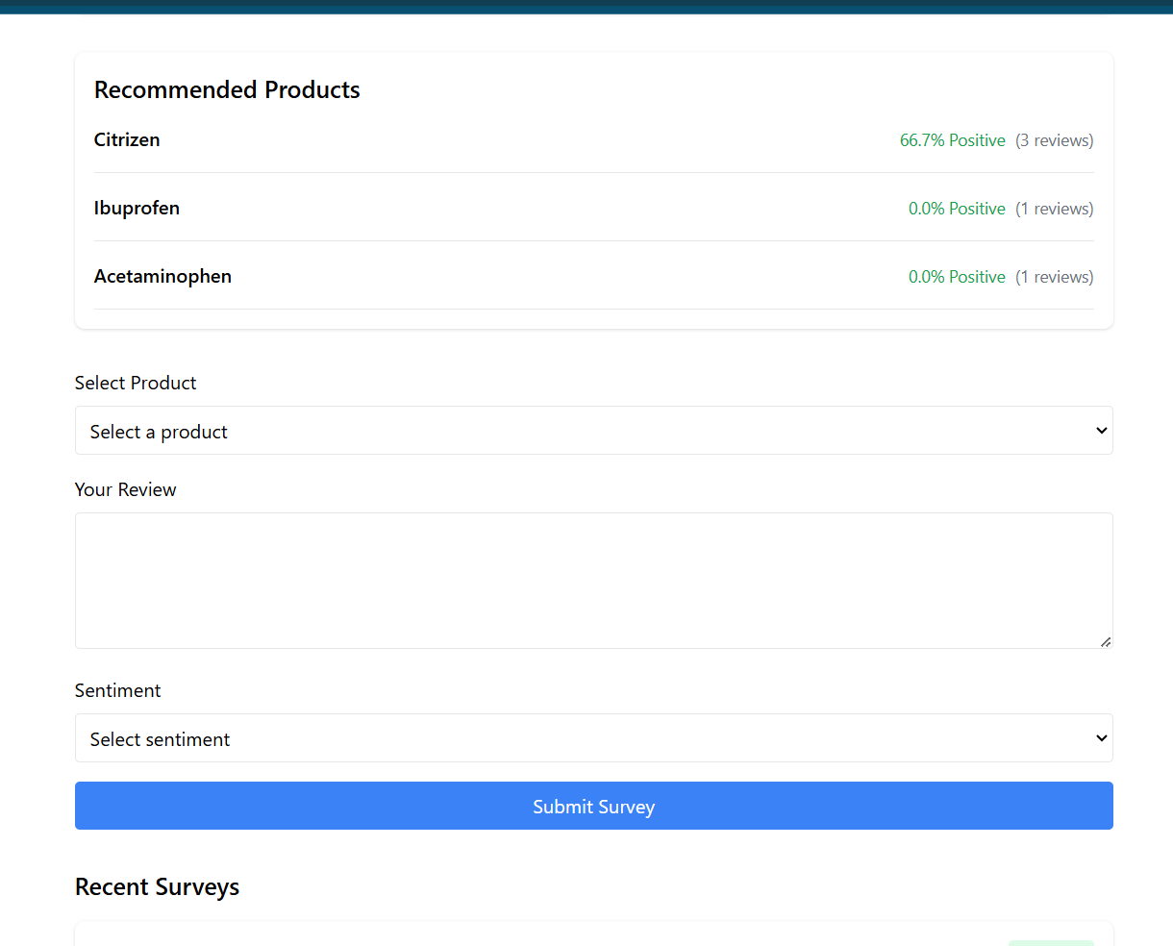
Outcomes

Slide 12
Conclusion
The MedPad project, aims to revolutionize the way Medical Representatives (MRs) engage with doctors, increase prescription rates, and ultimately drive pharmaceutical sales.
By leveraging data-driven insights, machine learning, and AI technologies, MedPad empowers MRs with personalized recommendations that optimize their time, enhance doctor interactions, and focus their efforts on high-impact opportunities.
Ultimately, MedPad is not just a tool—it’s a strategic enabler for pharmaceutical companies aiming to increase sales, expand market presence, and build sustainable growth in an increasingly competitive marketplace. By implementing this system, pharmaceutical companies can achieve the ambitious goal of 10x prescriptions, transforming both MR performance and overall business outcomes.

Slide 13
References
REFERENCES
1] Stoltzfus, M., Kaur, A., Chawla, A. Gupta, V., Anamika, F.N.U., & Jain, R. (2023).
The role of telemedicine in healthcare: an overview and update. The Egyptian Journal of Internal Medicine, 35, 49.
2] Bastos, D., Ribeiro, J., Silva, F., Rodrigues, M., Rabadão, C., Fernández-Caballero, A., Barraca, J.P., Rocha, N.P., & Pereira, A. (2021).
Security Mechanisms of a Mobile Health Application for Promoting Physical Activity among Older Adults. Sensors, 21(21), 7323.
3]Sangnim, T. (2024). Artificial intelligence-driven pharmaceutical industry: A paradigm shift in drug discovery, formulation development, manufacturing, quality control, and post-market surveillance.
European Journal of Pharmaceutical Sciences, 203, 106938.
4] Miklosik, A., Kuchta, M., Evans, N., & Zak, S. (2019). Towards the Adoption of Machine Learning-Based Analytical Tools in Digital Marketing. IEEE Access, 7, 85705–8517.
5] Fourkiotis, K.P., & Tsadiras, A. (2024). Applying Machine Learning and Statistical Forecasting Methods for Enhancing Pharmaceutical Sales Predictions. Forecasting, 6(1), 170–186
6] Stasevych, M., & Zvarych, V. (2023). Innovative Robotic Technologies and Artificial Intelligence in Pharmacy and Medicine: Paving the Way for the Future of Health Care—A Review.
Big Data Cogn. Comput. 7, 147.

Slide 14
Project Git hub Link:
medpad

Slide 15
Thank You

